Slide 1
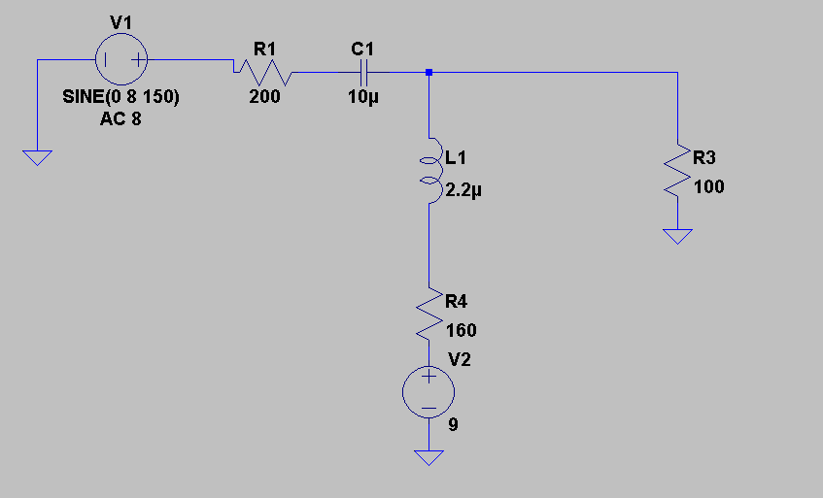
Progress Report – Keelin Becker-Wheeler and Oliver Kisielius
This is the design for our bias-t circuit, which is used to combine the AC signal from the microphone with the DC voltage from the battery.

Slide 2
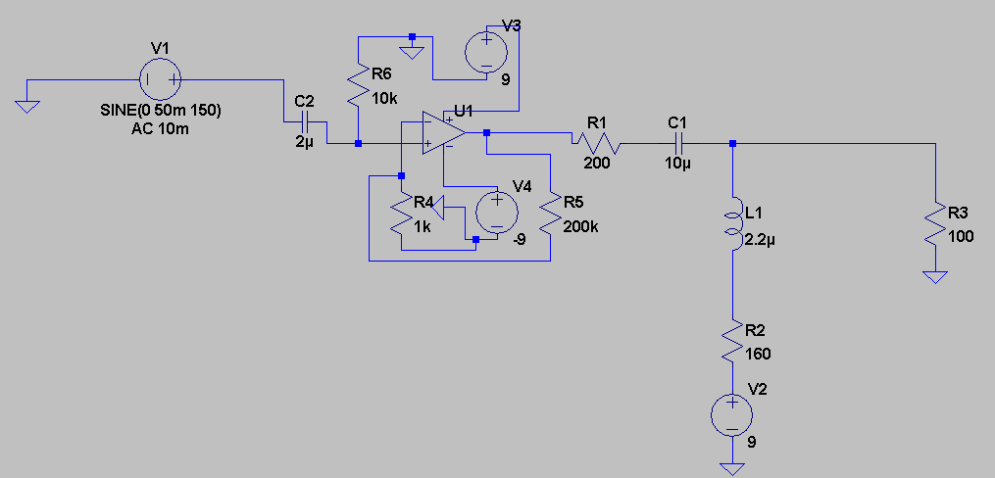
This is the design for our microphone amplifier and bias-t circuit. Source V1 here represents the microphone component. As shown in the following graphs, the output voltage is limited to a useful range of 2-5V regardless of input frequency or excessive microphone static.

Slide 3
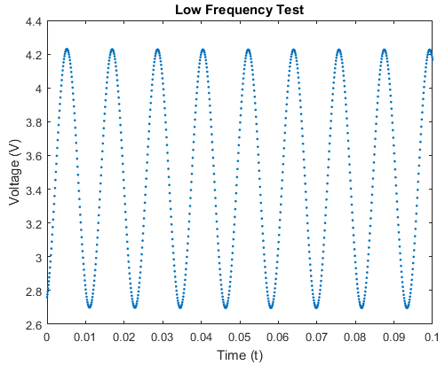
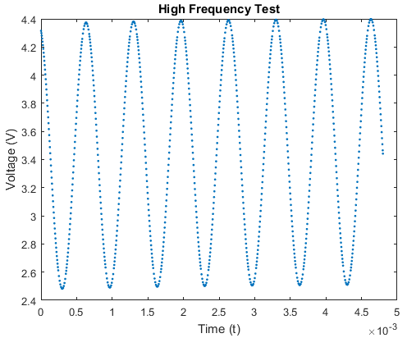
Here we see that when tested at microphone input frequencies of 85Hz (Low) and 1500Hz (High) the output voltage across our load is within the usable range of 2-5V and does not clip.

Slide 4
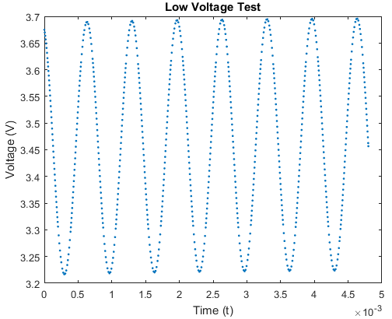
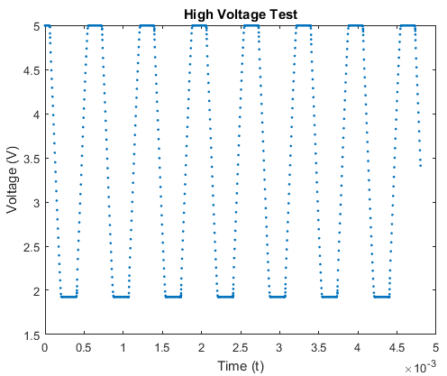
Here we see that when tested at microphone input voltages with amplitude (not peak-to-peak, because that’s ridiculous) of 5mV and 50mV, the output voltage across our load is within the usable range of 2-5V and will sooner clip than break the laser.

